Slide 1


http://www.journalmap.org
Jason Karl, Ph.D.
USDA-ARS Jornada Experimental Range
Notes:
Good afternoon. I’m Jason Karl. I’m a research scientist with the ARS Jornada Experimental Range. Jamin asked if I would give a presentation on a project we’ve been working on at the Jornada called JournalMap and to talk a little bit about the potential for JournalMap to become a source of knowledge for developing ESDs and a means of distributing certain aspects of ESD information and documentation.

Slide 2
Geographic-based literature searching
Results
Theme
Place name
General context
Semantic search
Relevant to theme
Relevant by similar ecological context
Relevant to location
Question: e.g., soil erosion in North American Southwest
Specific location
Ecologically similar areas
Geo-semantic search
Source: Karl et al. (2013)
Notes:
When you search for scientific literature using most of today’s widely used tools like Web of Knowledge or Google Scholar, you are largely limited to topic and keyword searches and perhaps some general context or location information like place names. From this kind of search you will get results that are relevant to your topic but only a portion of those results may be relevant to your particular location.
With the ability to add location information explicitly, though, allows you to hone your results down to a specific area. Additionally, explicit location-based searching also lets you query other spatial attributes like soils or climate to search for literature results that may not come from your particular area but may still be relevant because of their ecological context.

Slide 3
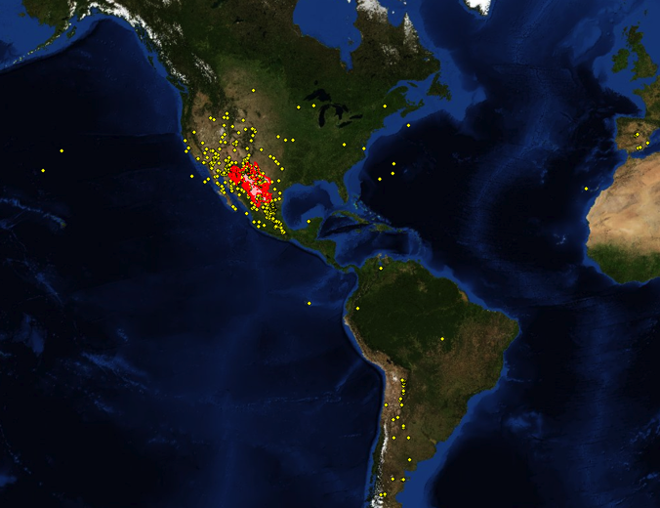
Example: Chihuahuan Desert Ecology Studies
Chihuahuan Desert
Studies from “Chihuahuan Desert” literature search
Web of Knowledge Search for “Chihuahuan Desert” in ecology journals. 784 articles could be mapped
282 (36%) actually in Chihuahan Desert
Doesn’t represent myriad articles in the area not using place name term
Notes:
Here is a real example of this for a Web of Knowledge literature search we did for ecological studies in the Chihuahuan Desert. My search here returned a little more than 1000 articles with the phrase Chihuahuan Desert in the title, keywords, or abstract. We looked at each of these articles and geotagged the ones we could based on where the study actually occurred. We were able to map almost 800 of the articles, whichi is a pretty good return. The map here clearly shows the result – only 36% of the studies we found actually occurred within the Chihuahuan Desert. But what this map doesn’t represent is all of those studies that occurred within that ecoregion but didn’t use those two geographic keywords.

Slide 4
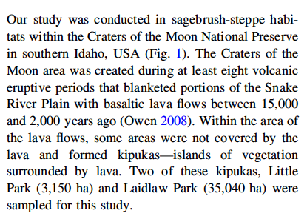
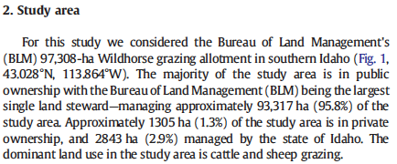
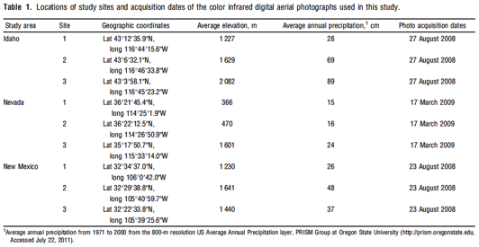
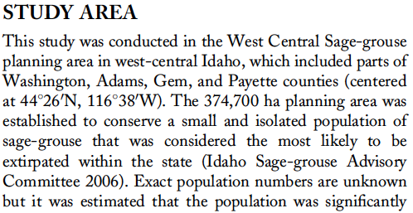
Challenge: Extracting location information from published studies
90%
of ecological studies report a study location, but use countless ways to do it
58%
of ecological studies report geographic coordinates for their study area
Notes:
The challenge is how to actually find and extract the location information from published studies. Here are some examples from published papers that illustrate the complexity of the problem. I should mention that I’m not skewering any other authors here – these examples are all from papers that I’ve published. You can see that just in these four examples there is a diversity of different ways to report study locations, from place names to coordinates in text to tables. So the location information is there in published studies, but getting it out can be pretty challenging.

Slide 5
Opportunity: leverage location information in studies
Location Reporting in Natural Resource Studies
Place Name Reported (32%)
Geographic Coordinate System (90%)
Coordinates Reported (58%)
Other Coordinate System (10%)
No Location (10%)
Data from JournalMap database of > 6,000 articles
Notes:
In scientific literature on natural resources, the majority of studies report some kind of location where the study was conducted. Those papers that don’t report a location are generally review papers, syntheses, opinions, or conceptual papers. Of the studies reporting a location, about 60% use some kind of coordinate in that study area description – either for a single point or to define a bounding box. Of the coordinates reported, about 90% are some format of a geographic latitude and longitude (i.e., degrees, minutes, seconds or decimal degrees). This represents a huge opportunity in improving knowledge discovery through scientific literature searching if we can rescue this information that’s locked away in the text of the studies.

Slide 6
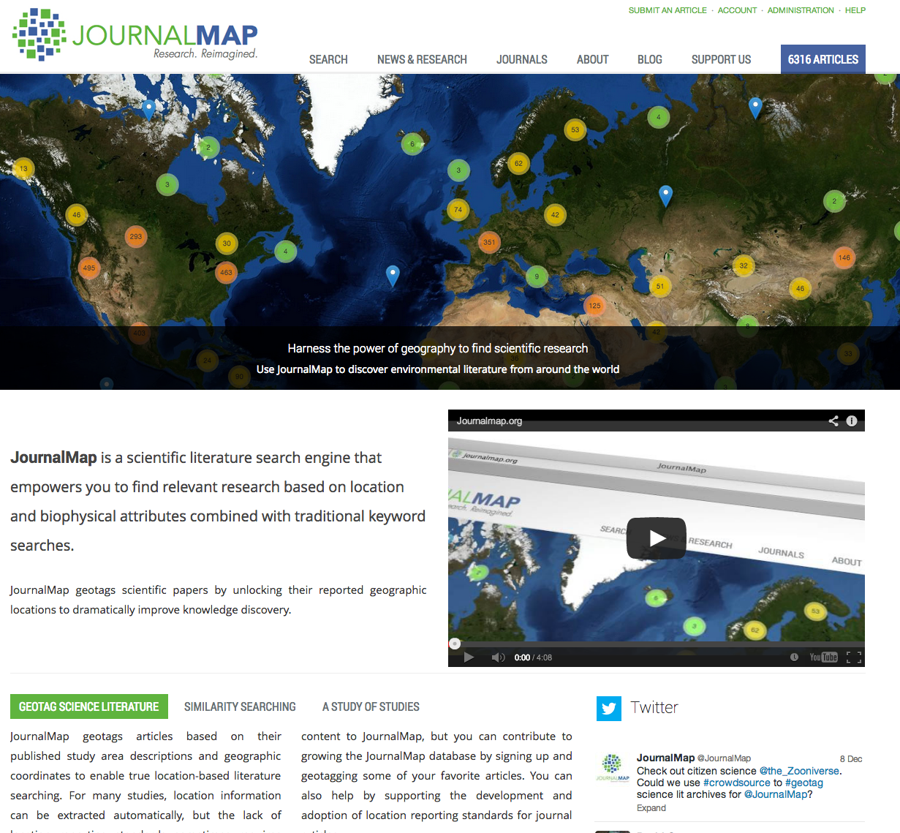
Notes:
This opportunity and some nifty algorithms for identifying and extracting coordinates from article text led us to create JournalMap. JournalMap is a scientific search engine that helps you find relevant research based on the location of a study using a map interface and a host of biophysical attributes. I’ll go into the specifics in a minute, but I want to reiterate that with JournalMap we are mapping the actual location where the study was conducted. To date we’ve focused on ecology, natural history, and agriculture journals, but the concept has application to any field where geography is important.

Slide 7
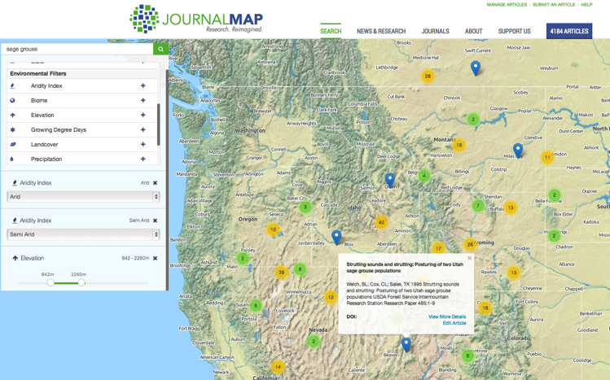
Searching/Filtering Articles
Key word/term searching
Filters for different environmental, location, and citation attributes are available for querying JournalMap in addition to key words/terms.
Categorical filters are additive (i.e., aridity index of arid OR semi-arid)
Continuous variable filtering set by a slider.
Study Locations are Mapped
(not author affiliations)
Basic citation information and a link to the article in the popup bubble.
Notes:
The heart of JournalMap is a database of geotagged articles that can be searched through an interactive map interface. Each article shows up as a map pin, and there can be multiple pins for any article with more than one study area. You can enter terms or topic words to search the titles, abstracts, and keywords of articles in the database. You can also add filters for different environmental, location, and citation attributes. These filters are additive and can be stacked to make complex queries. Clicking on any pin opens a pop-up with the citation info.

Slide 8
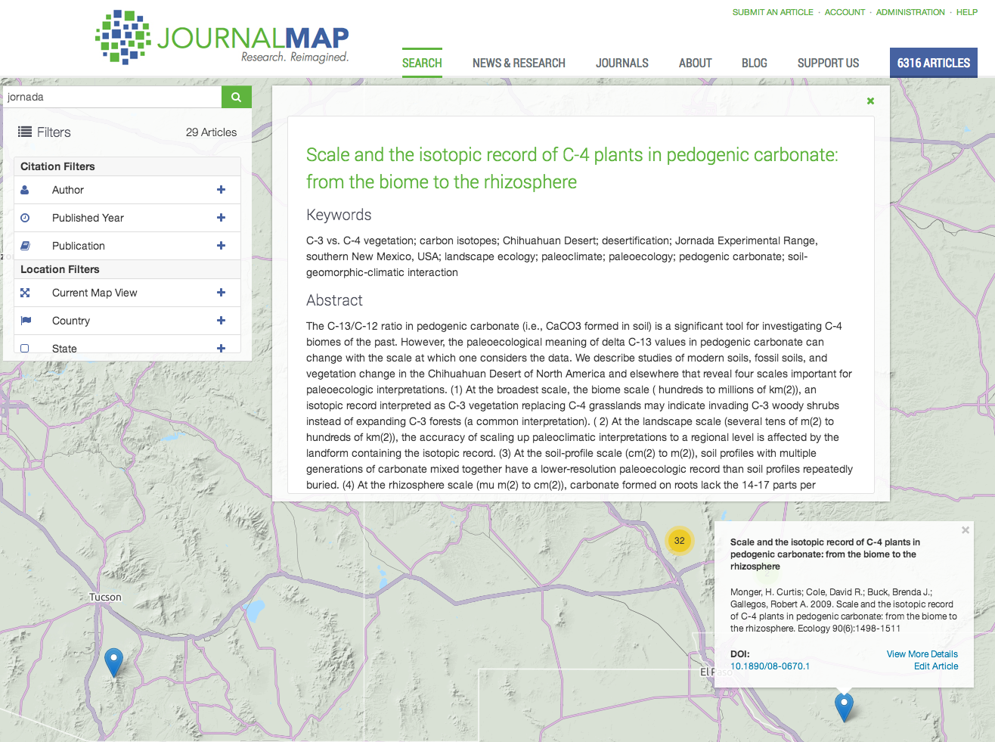
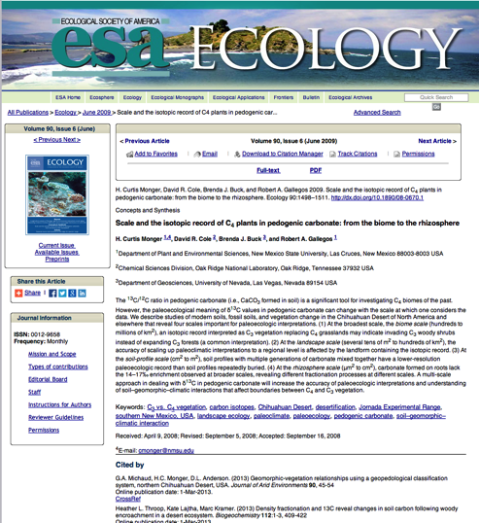
Articles Details & Access
Notes:
From the pop-up bubble for an article you can view a quick description of the article, read the abstract. JournalMap also includes links out to the publisher’s website for each article to access the full article text.

Slide 9
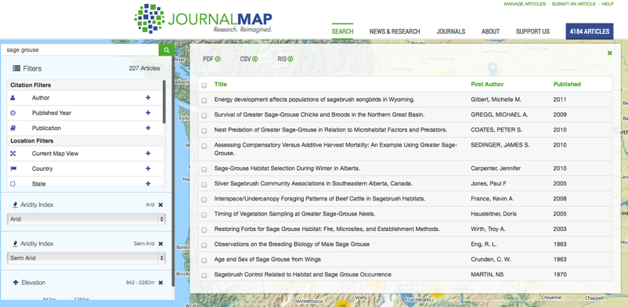
JournalMap search result exporting
Search results can be viewed as a list and exported from JournalMap in several formats.
Spatial download formats (e.g., shapefile, KML) coming soon.
Notes:
You can also view the results of each JournalMap search in a list view. From the list you can select the articles you are interested in and export them as a PDF, a CSV spreadsheet, or an RIS file for importing into a citation manager app like EndNote or Mendeley. We’re currently working on exporters for ESRI Shapefiles and Google Earth KML.

Slide 10
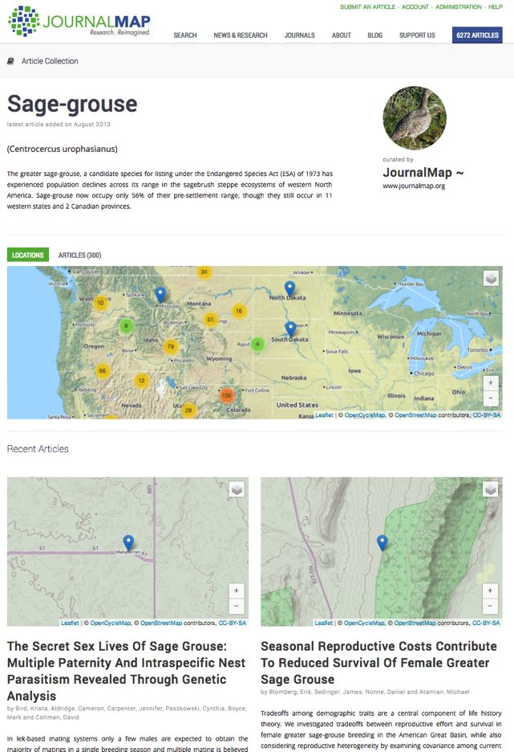
Collections
Saved sets of JournalMap articles
Georeferenced bibliographies
Static URLs
Notes:
One of the cool things we can do with JournalMap is to create collections of articles. Grouping articles by topic into a bibliography isn’t anything new – people have been doing it for a long time and there are plenty of applications out there for doing it. But JournalMap’s Collections of geotagged articles displayed on an interactive map puts a new spin on an old idea – giving easy access to visualize the geographic extent of knowledge on a topic or area. Collections in JournalMap are, in essence, saved searches, and each collection has a unique and static web address that can be put into documents or shared.

Slide 11
JournalMap System
XML Batch Import
Automated citation info capture
Coordinate recognition/extraction
JournalMap.org Website
Spreadsheet Import
JournalMap Database
Review/Approval
Data Exports
Website Article Submission
Semi-automated citation info capture
Coordinate recognition/extraction
Simple place name recognition
Online Data Services
Notes:
I mentioned earlier that pulling location information from published articles can be a real challenge, and I want to talk now about how we actually do that. We’ve been able to automate many aspects of JournalMap including capture of citation information. We use pattern recognition algorithms to detect and extract geographic coordinates from the text of articles or from information provided by users. We can currently recognize about 65 different coordinate formats. JournalMap is what I would consider to be a hybrid system – what can’t be automated is done manually – in other words, if an article can’t be automatically parsed, someone has to look at it and extract the location information by hand. This sounds laborious, but it is actually pretty quick in most cases and doesn’t take a highly specialized skillset. All records are reviewed by one of our project staff before they go live in JournalMap and appear on the website or any of the other products.

Slide 12
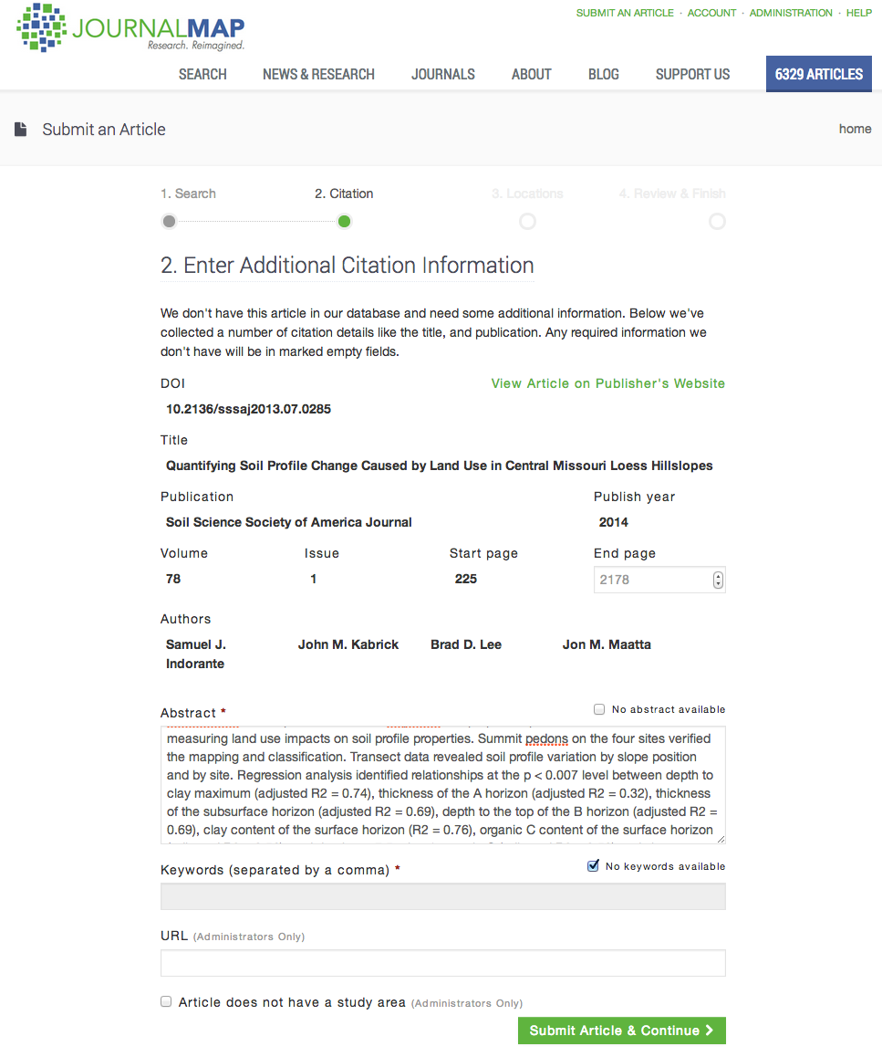
JournalMap Data Entry
Web-based system for entering articles
Automated lookup of citation info for journal articles
Batch/Bulk data uploads possible
CSV, XML formats
Endnote, Shapefile (pending)
Notes:
We’ve gone to great lengths to make it easy for users (as well as JournalMap project staff) to enter articles through the JournalMap website itself. We use article document object identifier (or DOI) numbers when available to grab all of the citation information, and in many cases the abstracts and keywords, for an article. While most publishers now use the DOI system, having a DOI isn’t necessary to add an article to JournalMap. If all you have is an URL, you can just list that for an article.

Slide 13
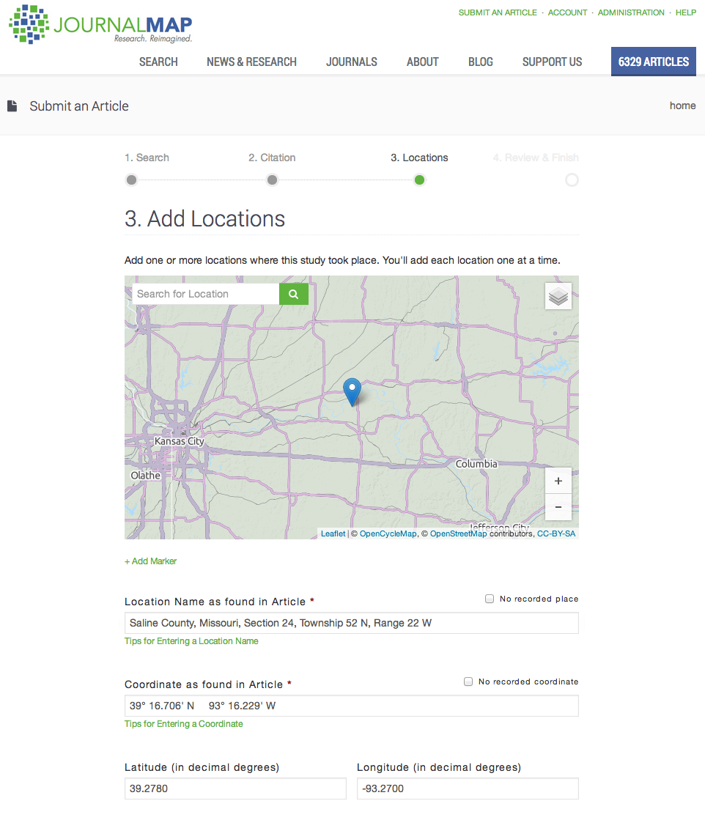
JournalMap Data Entry
Locations mapped from article text
Can have many locations for an article
Place name lookup
Automated recognition/parsing of coordinates
Manual geotagging
Currently only points
Lines, polygons pending
Notes:
The next step in the article submission process is to geotag the article by mapping the study area locations. Again, multiple locations can be mapped for an article that had more than one study area. We recommend copying/pasting the actual study area description from the article text. This part of JournalMap will do simple place-name recognition and lookup for common places. This form also implements our coordinate parsing engine so if there are coordinates in the text it will automatically find and map them. If all else fails, you can always drop a pin on the map manually or grab a pin and move it. Currently with JournalMap we are dealing only with point locations for study areas. This is an obvious limitation, especially for larger study areas, and we’re in the process of adding functionality for lines and polygons.

Slide 14
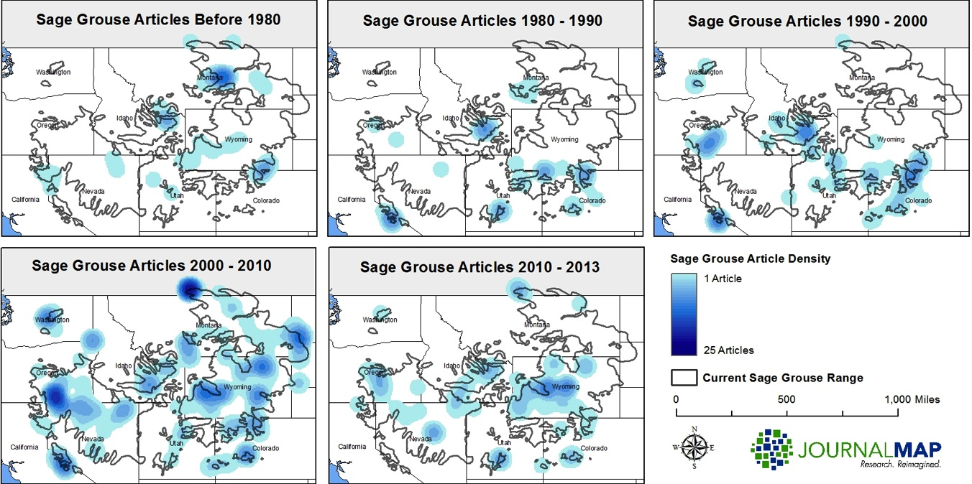
JournalMap Applications
Distribution of knowledge for topics
Knowledge hot/cold spots over time
Notes:
Let’s shift gears a little bit now and talk about some of the benefits of JournalMap and applications of georeferenced literature outside of searching for new sources. Having a comprehensive map of studies lets us analyze the distribution of knowledge and identify potential hot spots & cold spots. In this example we did a fairly comprehensive search for Sage Grouse literature and geotagged all the references we could find. Breaking the results out by time period lets see how the knowledge of Sage Grouse evolved over time and identify centers of sage grouse research like eastern Idaho and potential gaps like eastern Nevada. This kind of information could help direct research & inform conservation efforts for the species.

Slide 15
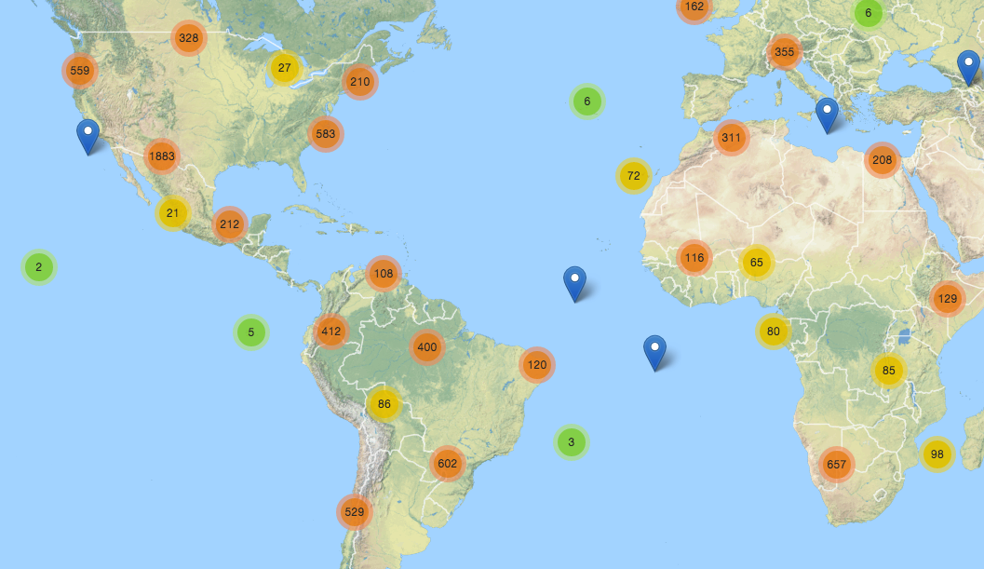
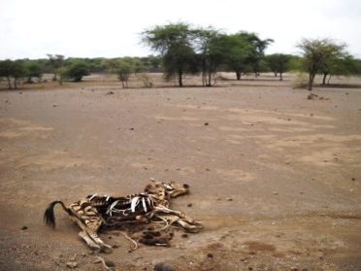
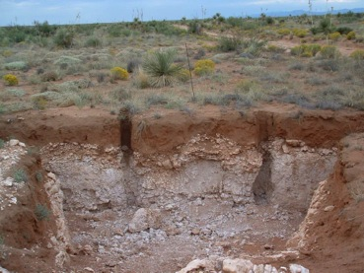
JournalMap Applications
Transfer of knowledge to environmentally-similar areas
Based on attributes like soils and climate
Knowledge Transfer
(Similar Climate & Soils)
Notes:
Another potential application of geotagged knowledge sources is in identifying sources that may contain relevant to understudied regions of the world. But in order for knowledge to be transferable, it must have come from someplace with a similar context. For example, research in southern New Mexico into land management practices to minimize erosion and prevent drastic state changes may be applicable to areas with similar soils and climate in southern Africa. With JournalMap we can define environmental similarity based on attributes like soil properties and climate variables in order to find knowledge from research rich areas and apply it to research poor ones for things like sustainable agriculture.

Slide 16
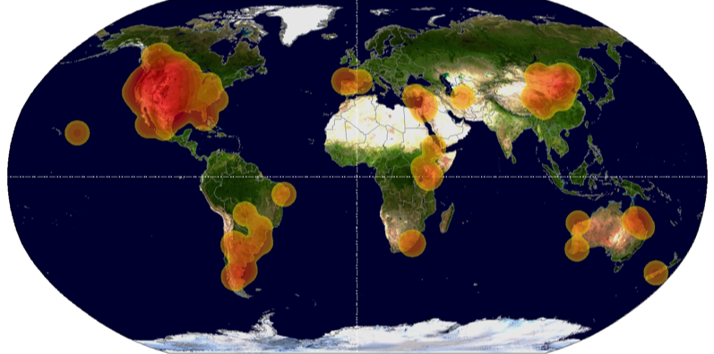
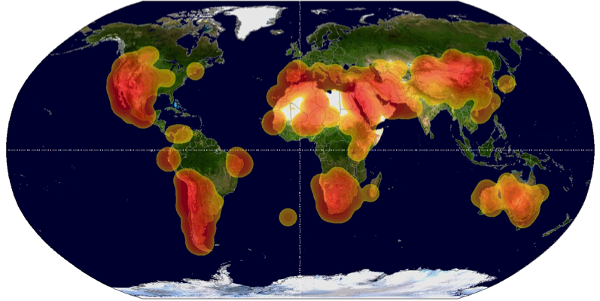
JournalMap Applications
Evaluations of bias and knowledge gaps
All Articles from Two Journals (2000 to 2012)
Rangeland Ecology
& Management
Journal of Arid Environments
Notes:
Extending the concept from a couple of slides ago of evaluating knowledge distribution, JournalMap’s georeferenced literature database can also be used to evaluate knowledge sources themselves. Consider this example that compares the distribution of studies from entire journal archives of Rangeland Ecology & Management and Journal of Arid Environments over the same time period to look for knowledge gaps or potential biases. These two journals have very similar scopes but markedly different geographic distributions.

